Slide 1

Historical Network Research
Dr Marten Düring, marten.during@cvce.eu
CVCE DH Lab Luxembourg
Slides and additional materials available at
http://martenduering.com/links/

Slide 2
Topics
What is SNA?
SNA and history
Approaches in historical research
Should I do network analysis?
Useful resources
First thoughts on project outlines

Slide 3
1. What is SNA?

Slide 4
What is a network?
Wikipedia:
“Social network analysis views social relationships in terms of network theory, consisting of nodes (representing individual actors within the network) and ties (which represent relationships between the individuals, such as friendship, kinship, organizations, sexual relationships, etc.)”
http://en.wikipedia.org/wiki/Social_network_analysis

Slide 5
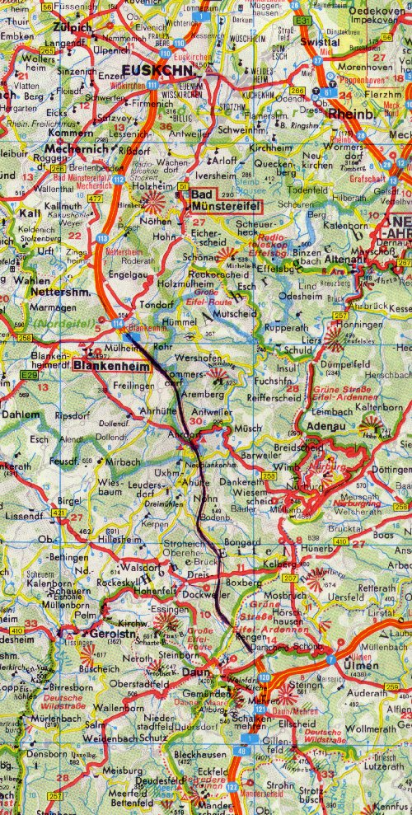
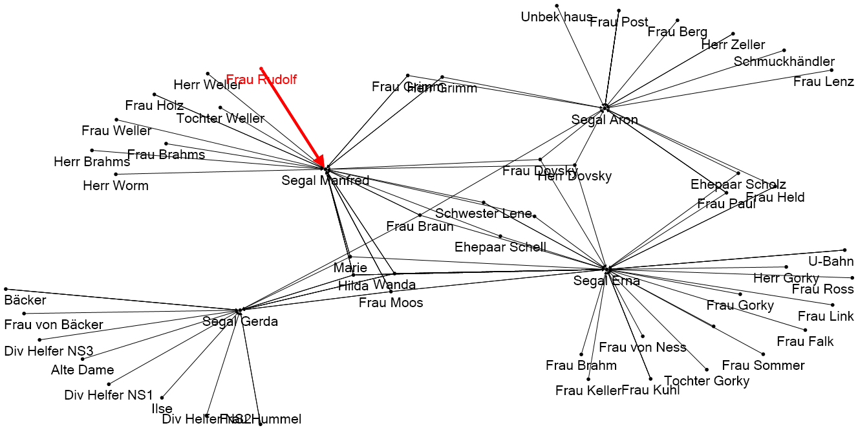
The purpose of network visualisations
Reduction
Abstraction
Categorization
Targeted representation
Main objective: Orientation
See: Lothar Krempel: Visualisierung komplexer Systeme. Grundlagen der Darstellung mehrdimensionaler Netzwerke.
Campus Verlag 2005
Notes:
VK

Slide 6
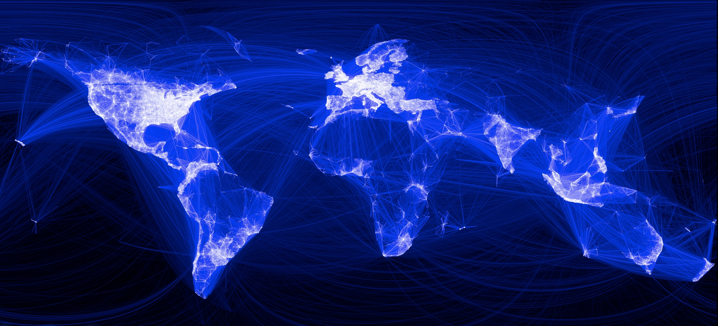
Examples – Facebook friendships

Slide 7
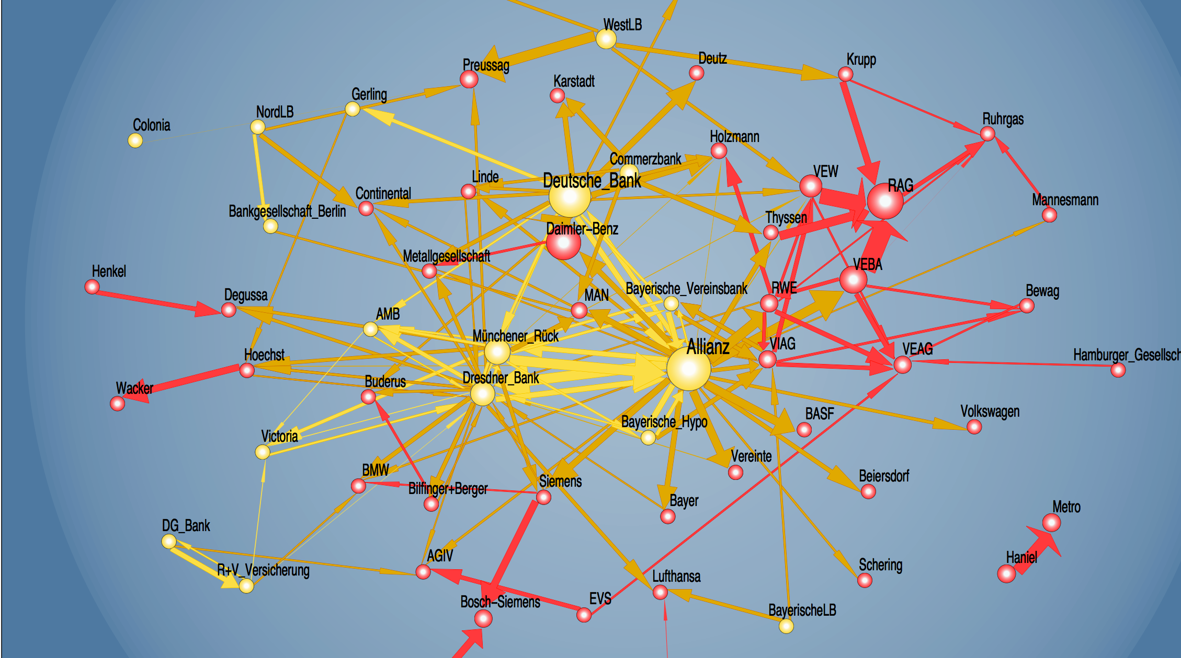
Examples – Deutschland AG 1996
http://www.mpi-fg-koeln.mpg.de/pu/workpap/wp03-9/wp03-9.html

Slide 8
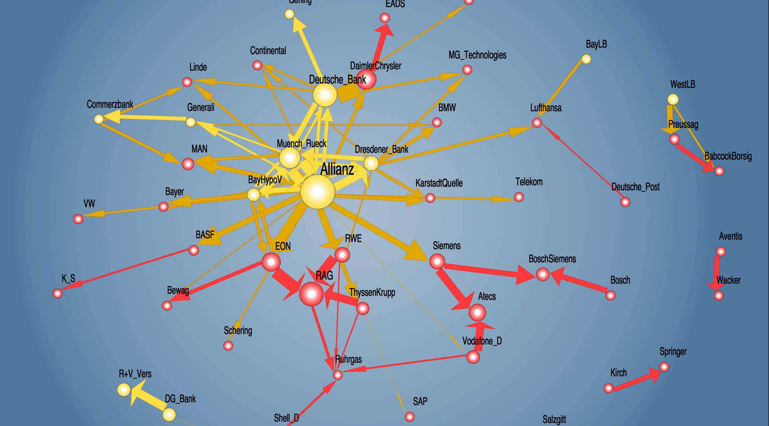
Examples – Deutschland AG 2000
http://www.mpi-fg-koeln.mpg.de/pu/workpap/wp03-9/wp03-9.html

Slide 9
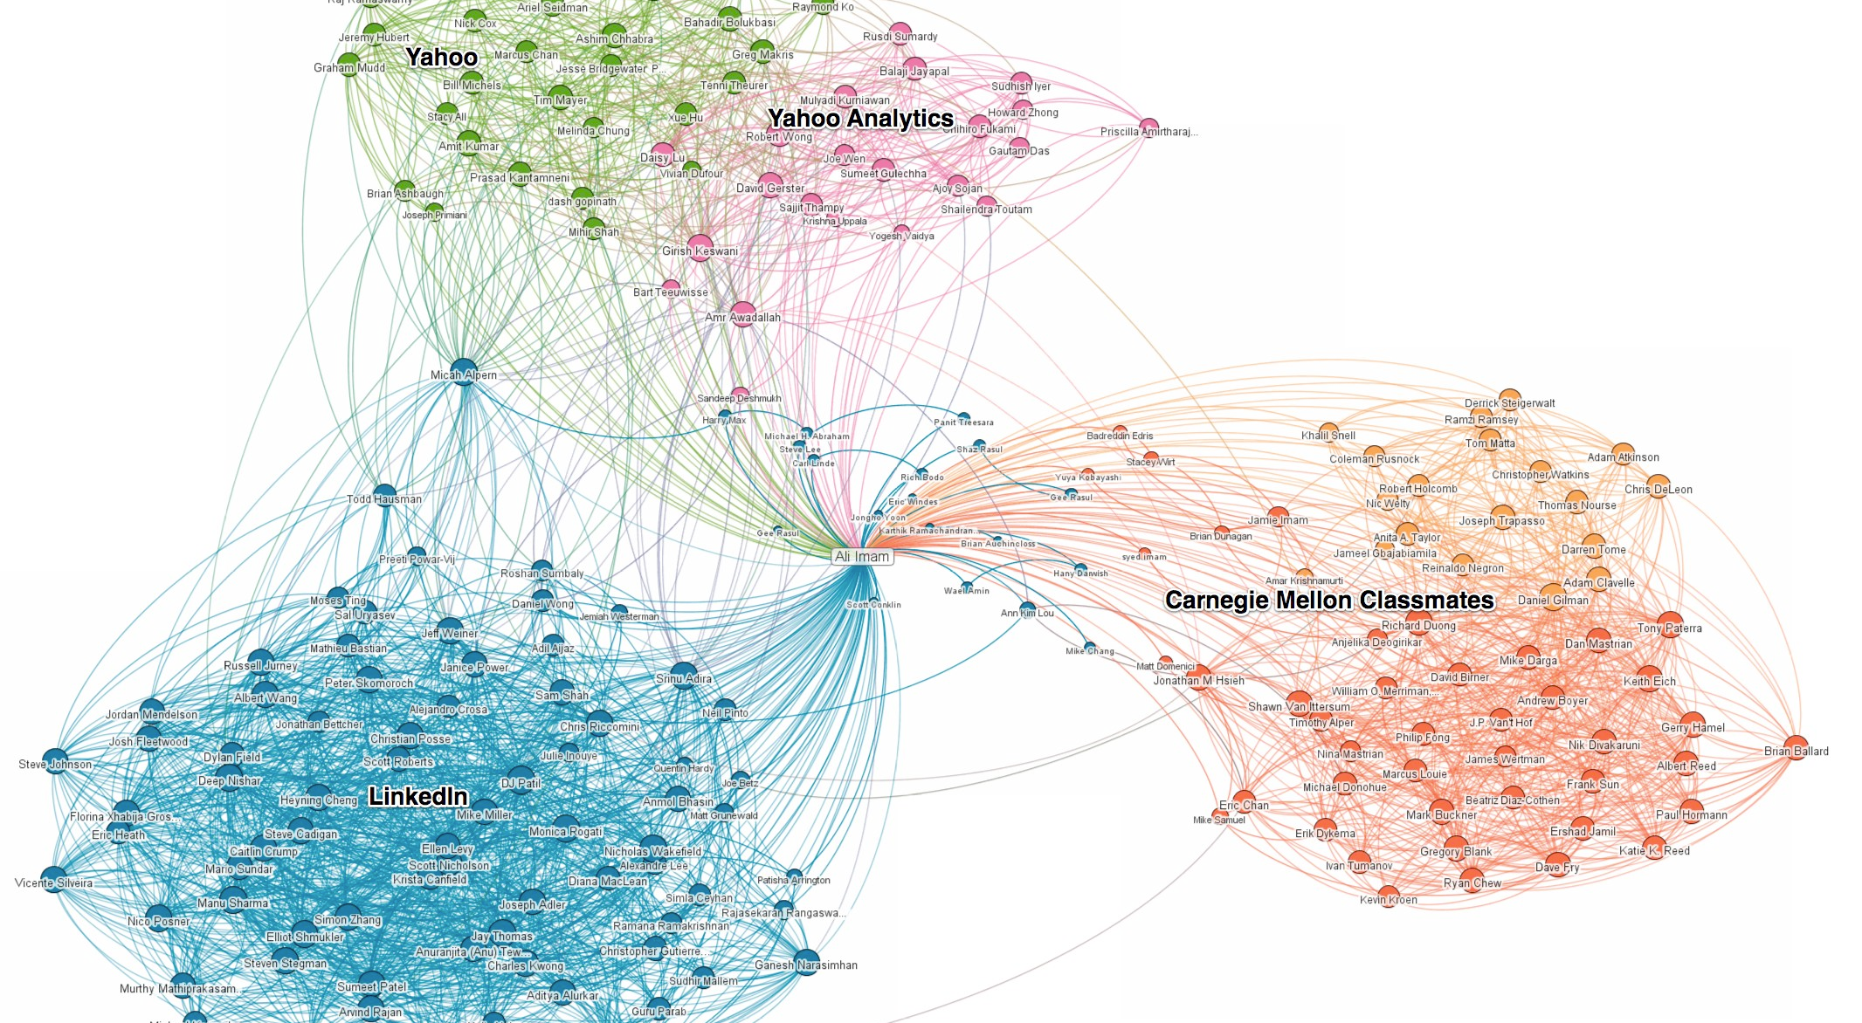
Examples – your LinkedIn relations
http://blog.linkedin.com/2011/01/24/linkedin-inmaps/

Slide 10
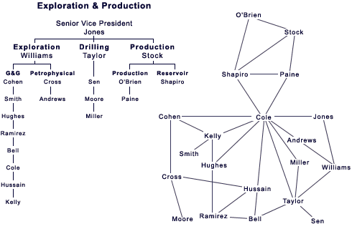
Examples - Comparing structures
“a large petroleum organization”
http://www.robcross.org/images/ona/sna_chart_01.gif

Slide 11
Networks are flexible
Examples of types of ties:
“is Facebook friend of”
“has stocks from”
“talks to”
“is party member together with”
“lives in the vicinity of”
“lends money to”
“helps with”
….

Slide 12
Added value for sociologists
„[T]he survey is a sociological meatgrinder, tearing the individual from his social context and guaranteeing that nobody in the study interacts with anyone else in it. It is a little like a biologist putting his experimental animals through a hamburger machine and looking at every hundredth cell through a microscope; anatomy and physiology get lost, structure and function disappear, and one is left with cell biology.“
Freeman 2004 – The Development of Social Network Analysis, p. 13.

Slide 13
Social Network Analysis
Typically, analysis of interaction and exchange processes in groups of social actors based on the premise, that relations between them are of epistemic value
Collection, visualisation and computation of data
Theory + method

Slide 14
2. SNA and history

Slide 15
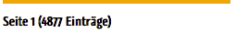
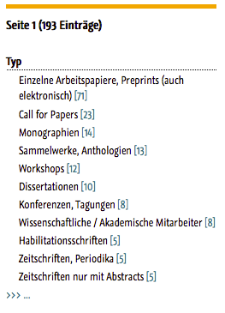
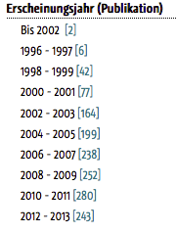
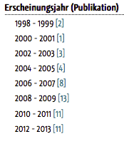
Network Analysis and History
« Netzwerk »
« Netzwerkanalyse »
HSOZKULT, 26.11.2014

Slide 16
Social ties and history
Network-like metaphors (web, strings, tied up…)
« Structure »
Prosopographies
Group biographies
Kinship, Genealogy
Economic and academic exchange
…

Slide 17
Usages of « network »
Buzz-word
Metaphor
Self-description of historical agents
Construction of a research object
Social Network Analysis theories and methods, Graph theory and Network Science

Slide 18
Historical Network Research
Historical Method + Social Network Analysis
Pioneers:
Robert Gould, Claire Lemercier, Charles Wetherell & Barry Wellman, Wolfgang Reinhardt,
John Padget & Christopher Ansell, Peter Bearman, Katherine Stovel…
Lemercier, Reitmayer/Marx, Neurath/Krempel, Gorißen, Boyer, Düring/v. Keyserlingk [2015]
http://historicalnetworkresearch.org/bibliography/#1

Slide 19
Historical Network Research
Network analysis is a tool.
Not an end in itself.
Pioneers:
Robert Gould, Claire Lemercier, Charles Wetherell & Barry Wellman, Wolfgang Reinhardt,
John Padget & Christopher Ansell, Peter Bearman, Katherine Stovel…
Lemercier, Reitmayer/Marx, Neurath/Krempel, Gorißen, Boyer, Düring/v. Keyserlingk [2015]
http://historicalnetworkresearch.org/bibliography/#1

Slide 20
Historical Network Research
Research question and data models are intertwined.
Pioneers:
Robert Gould, Claire Lemercier, Charles Wetherell & Barry Wellman, Wolfgang Reinhardt,
John Padget & Christopher Ansell, Peter Bearman, Katherine Stovel…
Lemercier, Reitmayer/Marx, Neurath/Krempel, Gorißen, Boyer, Düring/v. Keyserlingk [2015]
http://historicalnetworkresearch.org/bibliography/#1

Slide 21
Added value for historians
Analysis of complex relational structures
Flexibility to define actors, relations and attributes
Easy to integrate with trad. research practices
Complexity of social structures changes is no longer an obstactle, but an object of research

Slide 22
3. Applications in historical research

Slide 23

Martin Stark, Soziale Einbettung eines ländlichen Kreditmarktes im 19. Jahrhundert
Ohmenhausen
http://ubt.opus.hbz-nrw.de/volltexte/2014/839/

Slide 24
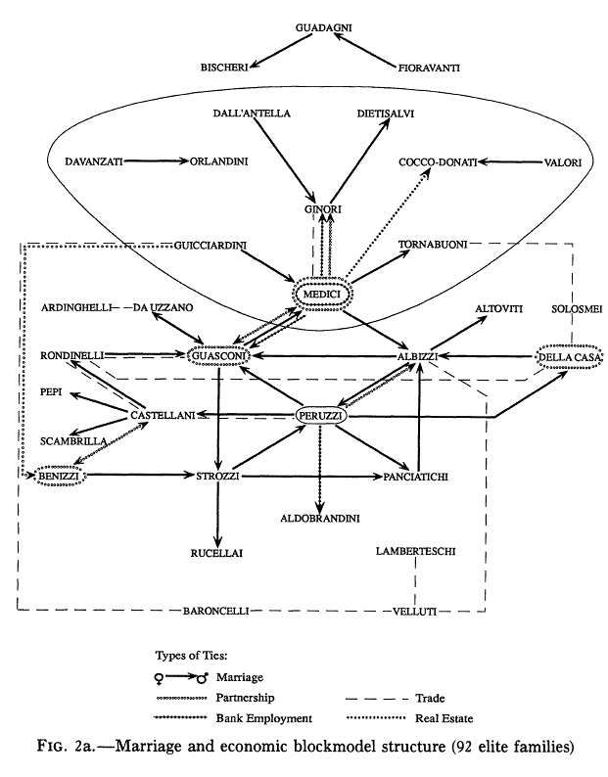
Padgett/Ansell, Robust Action and the Rise of the Medici, 1400-1431
http://home.uchicago.edu/~jpadgett/papers/published/robust.pdf

Slide 25
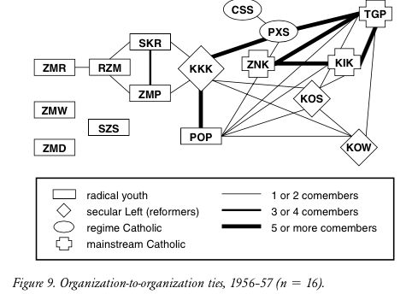
Maryjane Osa, Solidarity and Contention
https://www.upress.umn.edu/book-division/books/solidarity-and-contention

Slide 26
Ulrich Eumann, Communist resistance in Cologne
Ulrich Eumann/Jascha März: Netzwerke des Widerstands in Köln
1933-1945. Forschungsprojekt, in: The International Newsletter of Communist Studies Online XVI (2010), no. 23, p. 37-41.

Slide 27
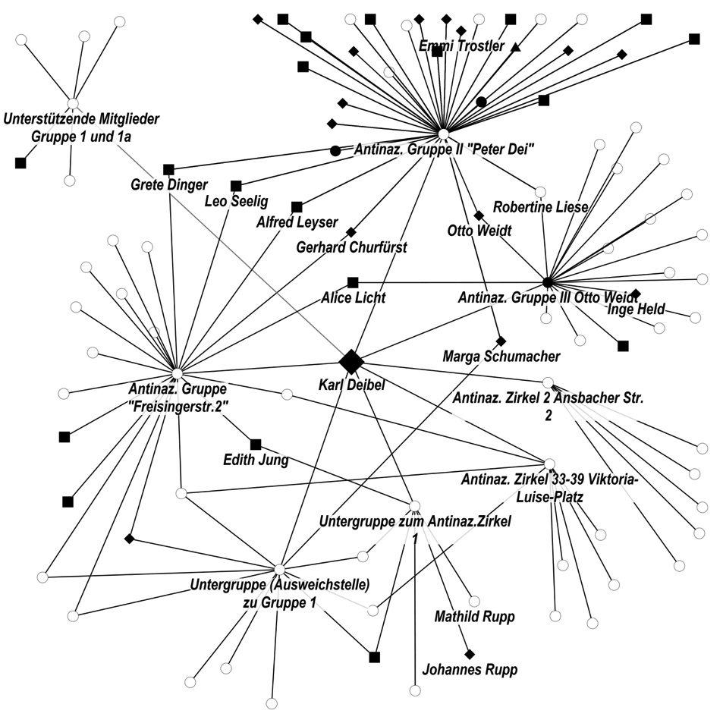
Covert support networks for persecuted Jews
Marten Düring, Verdeckte Hilfsnetzwerke im Nationalsozialismus. Berliner Hilfsnetzwerke für verfolgte Juden, de Gruyter [2015]

Slide 28
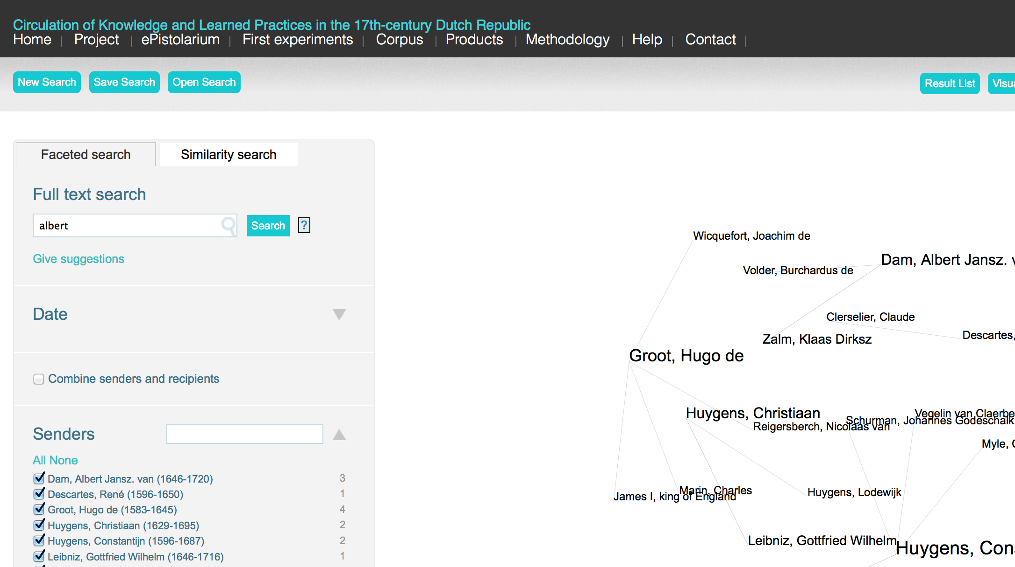
ePistolarium
http://ckcc.huygens.knaw.nl/epistolarium/

Slide 29

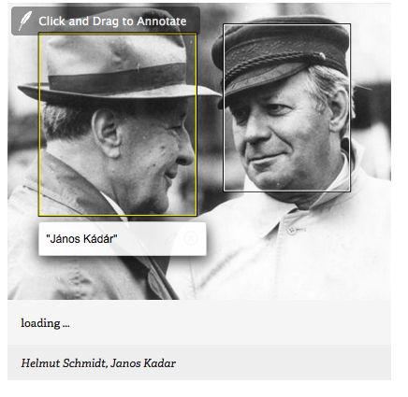
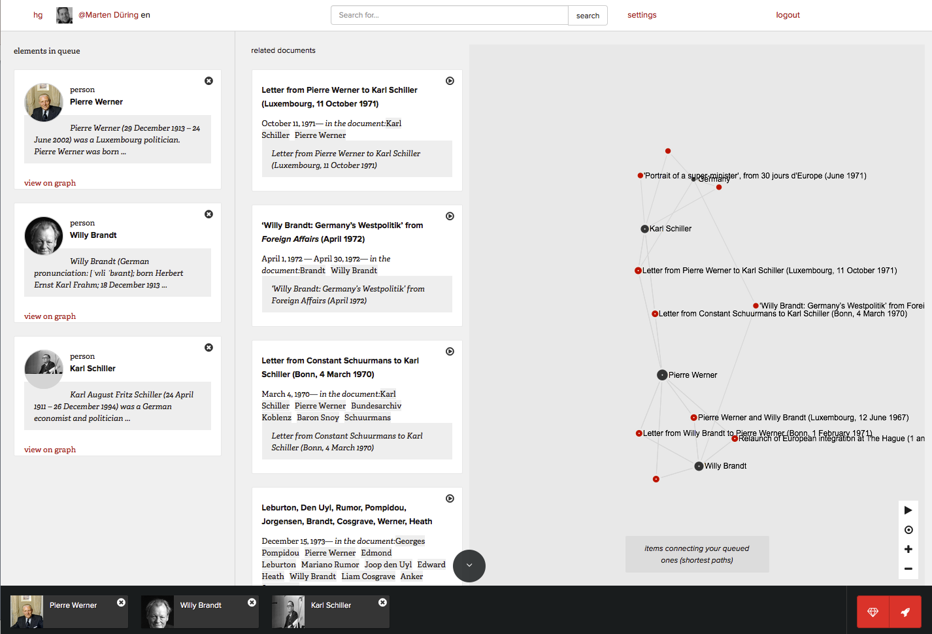
histoGraph
http://histograph.eu/

Slide 30
...other projects
Death registers
Invitations
Interrogations
Law suits
Credit markets
Parties
Shipping routes
Brick production
Espionage
Letters
Treaties
Architectural styles
Land ownership
Carrier paths
Escape routes
Name disambiguation
Cinema going
Oral history Interviews
Parliamentary debates
Citations
...
http://historicalnetworkresearch.org/

Slide 31
Commonalities
Analysis of complex relations
Relations have explanatory value
Integration with trad. research practices
Source-based, hypothesis-driven concepts of nodes and ties

Slide 32
4. “Should I do network analysis”?

Slide 33
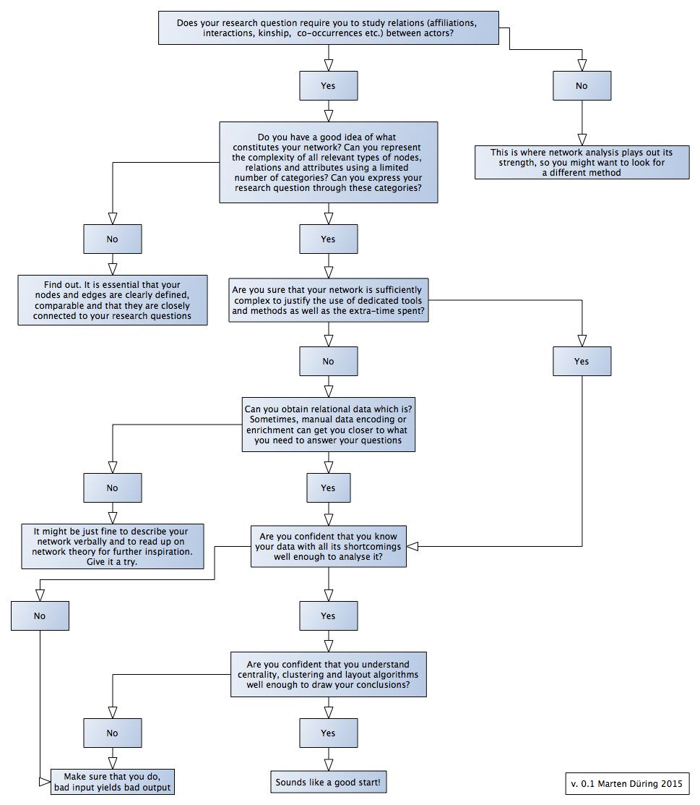
4. “Should I do network analysis”?
Relationality
Conceptualisation
Necessity
Data suitability
Data criticism
Data analysis
Interpretability
Now at http://martenduering.com/links/
Soon at http://cvcedhlab.hypotheses.org/

Slide 34
Relationality
Does your research question require you to study relations (affiliations, interactions, kinship, co-occurrences etc.) between actors?
What does a relation mean to you?
Why do you want to study patterns which emerge from social relationships?

Slide 35
Conceptualisation
Do you have a good idea of what constitutes your network?
Can you represent the complexity of all relevant types of nodes, relations and attributes using a limited number of categories?
Can you express your research question through these categories?
Can you test hypotheses with these categories?

Slide 36
Necessity
Are you sure that your network is sufficiently complex to justify the use of dedicated tools and methods as well as the extra-time spent?

Slide 37
Data suitability
Can you obtain usable relational data?
Sometimes, manual data encoding or enrichment can get you closer to what you need to answer your questions

Slide 38
Data criticism
Are you confident that you know your data with all its shortcomings well enough to analyse it?

Slide 39
Data analysis
Are you confident that you understand centrality, clustering and layout algorithms well enough to draw your conclusions?

Slide 40
Interpretability
Are you confident that the results of your analyses can be used to answer your questions?
Are you sure that your visualisation has an added value for your audience?

Slide 41
PS: Reminders
Tools and methods are no ends in themselves
Neither are visualisations and cluster or centrality analyses
SNA has a lot to offer in terms of methods and theories, relevant empirical studies can inspire historical research

Slide 42
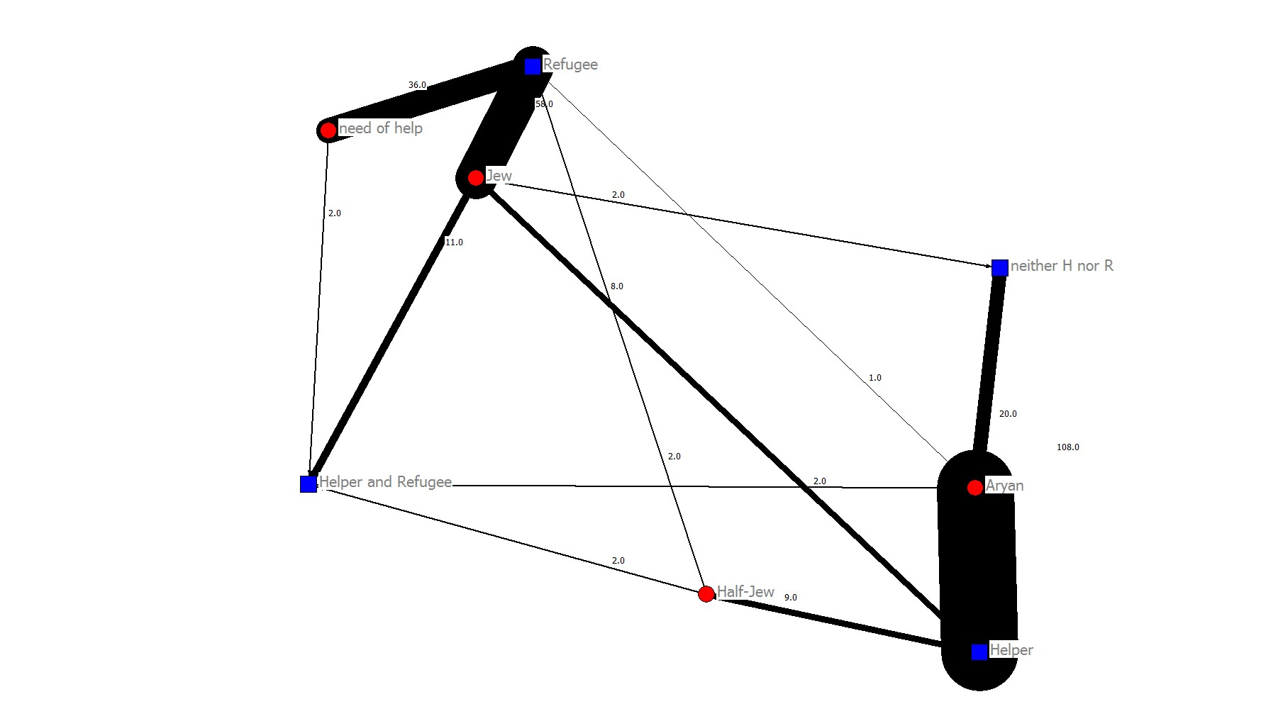
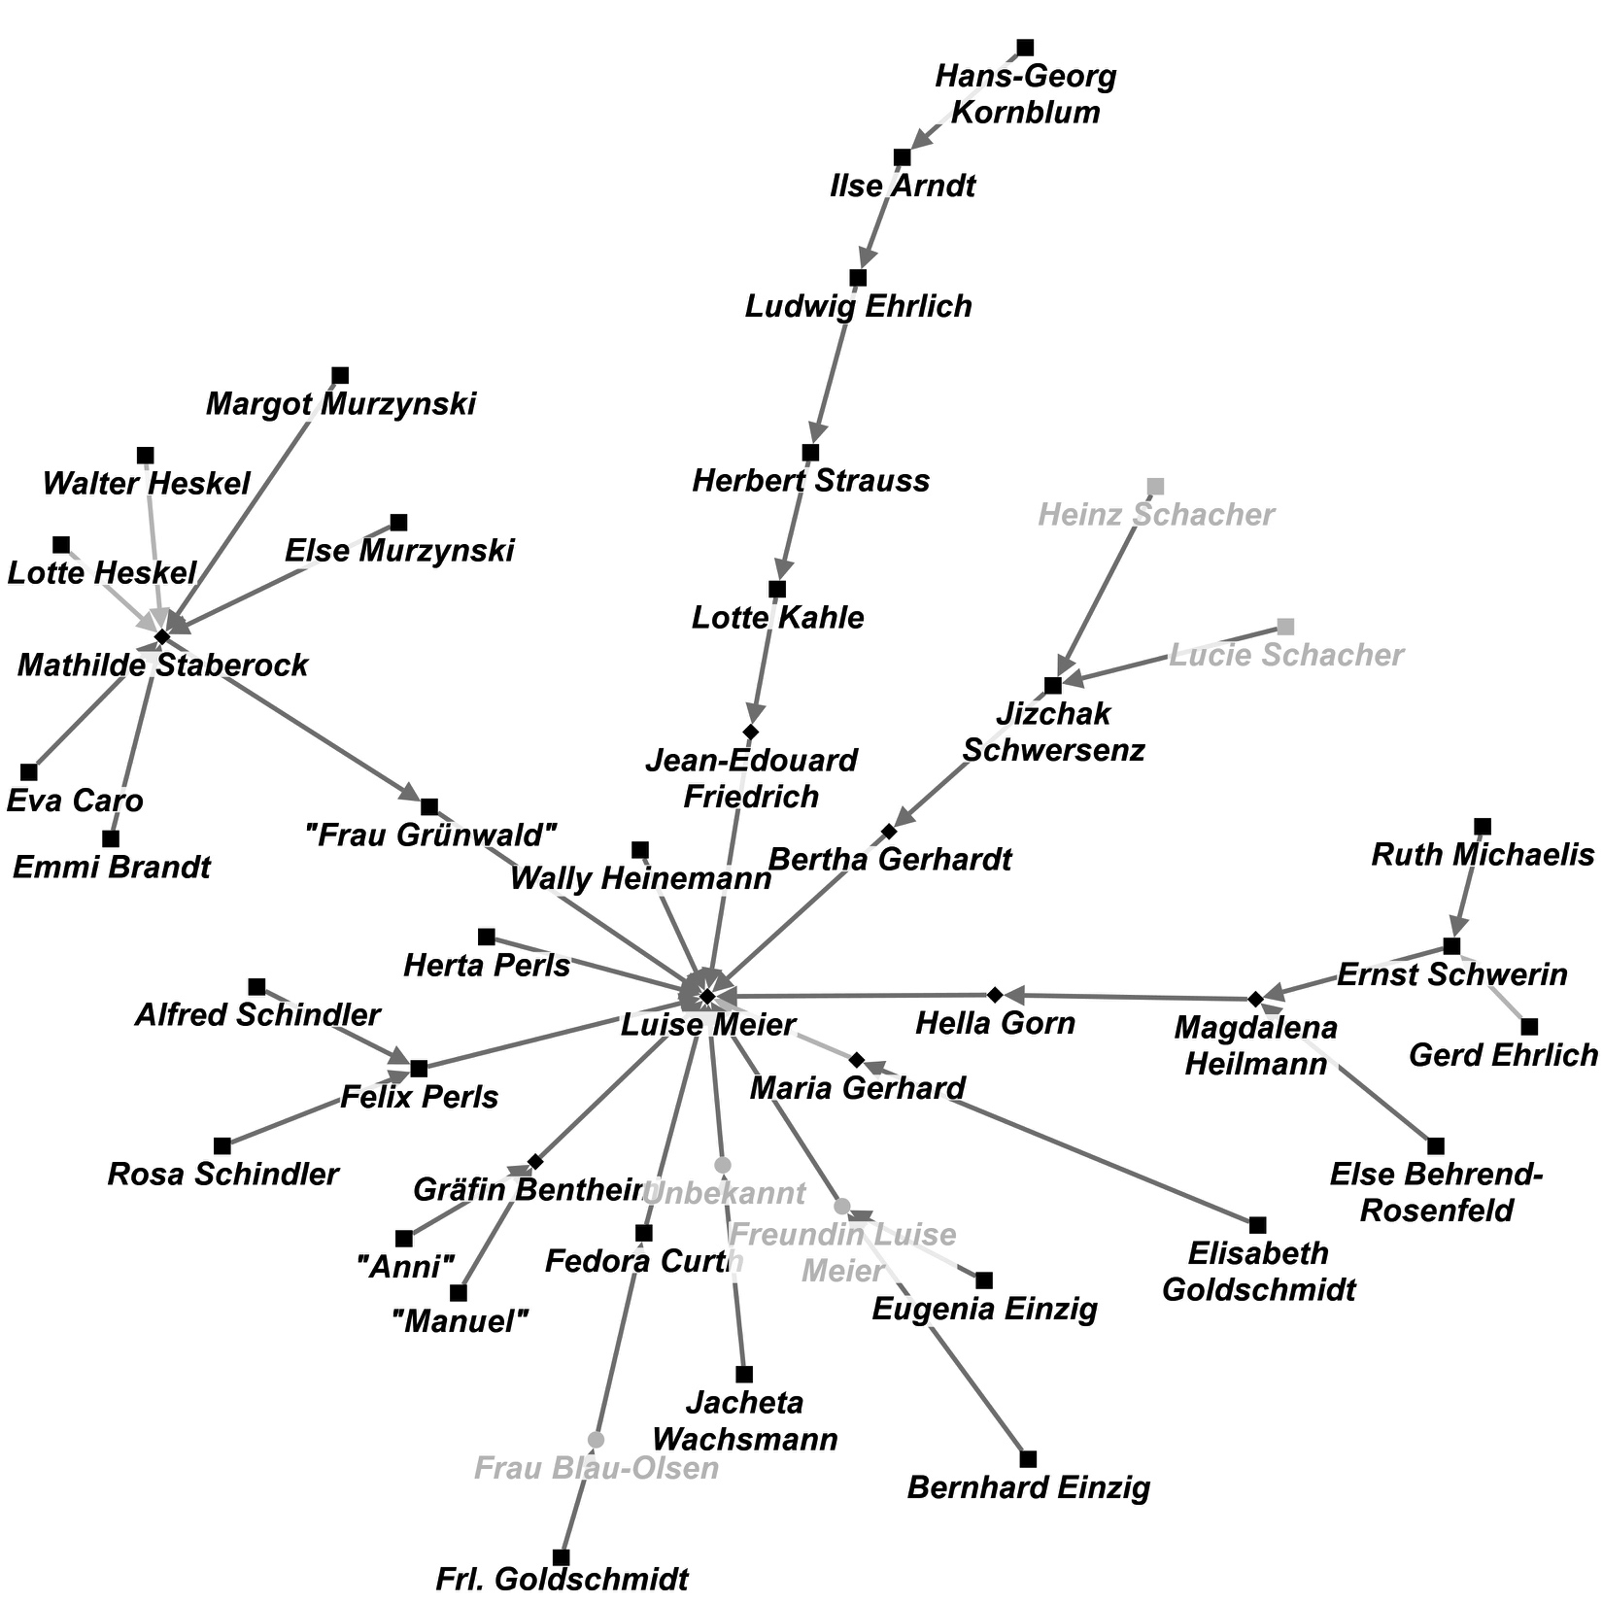
2 Types of visualisations
Exploration, expert knowledge required
Illustration, public

Slide 43
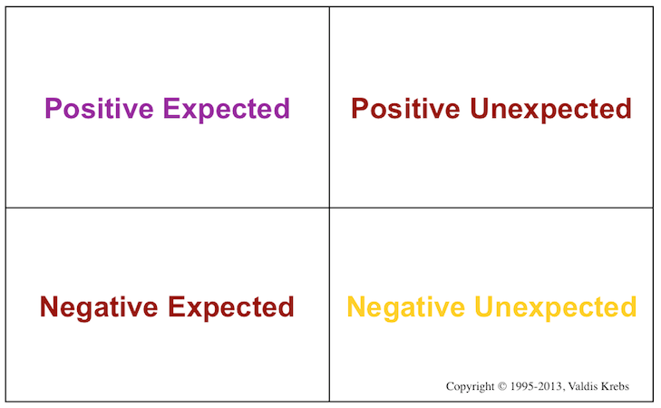
What to expect from SNA
Valdis Krebs: Network Discovery Matrix, http://www.orgnet.com/sna.html

Slide 44
5. Useful resources

Slide 45
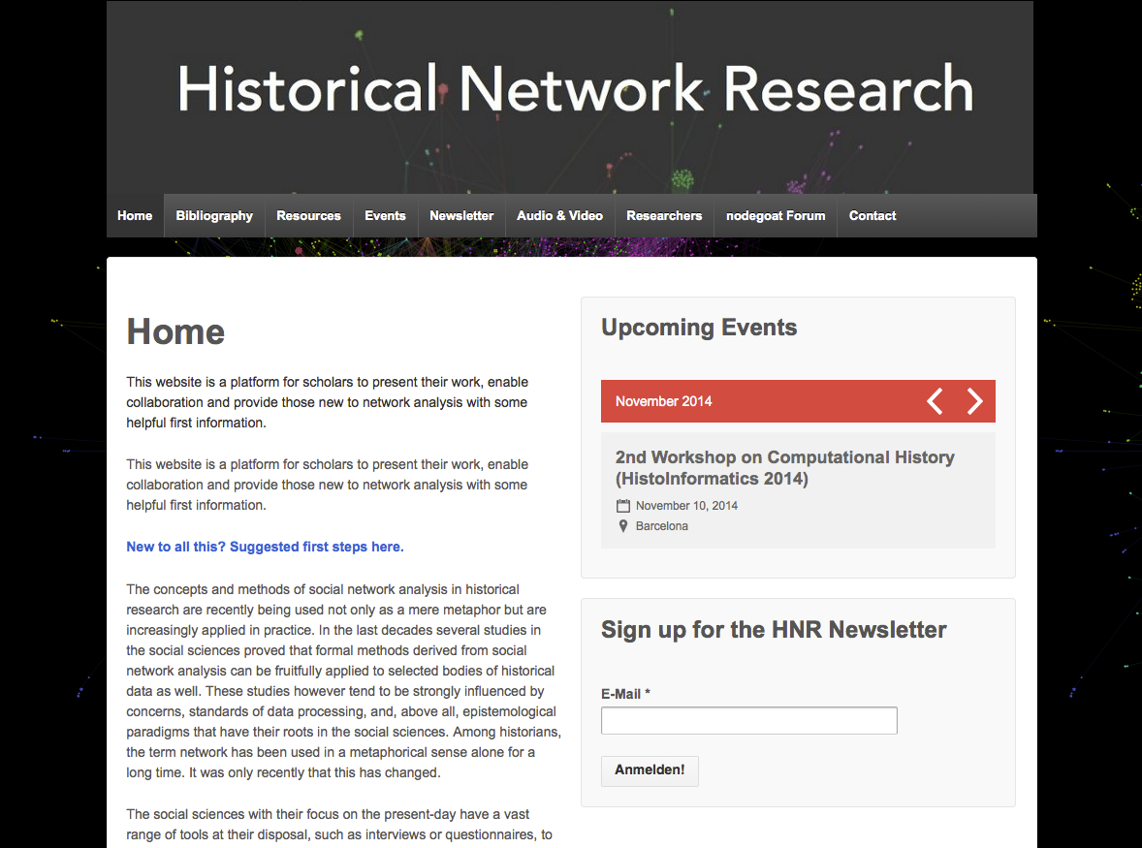
http://historicalnetworkresearch.org/
http://historicalnetworkresearch.org/

Slide 46
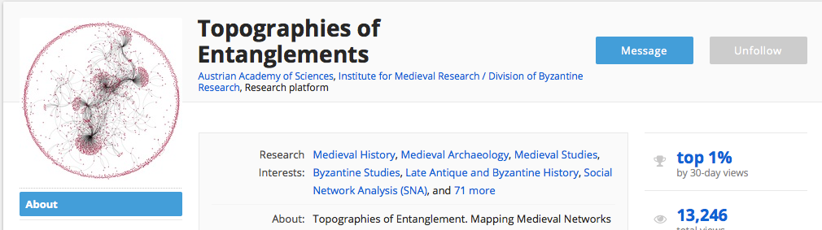


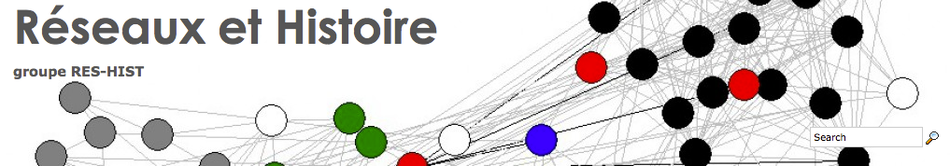
Other initiatives
https://oeaw.academia.edu/
TopographiesofEntanglements
http://connectedpast.soton.ac.uk/
http://reshist.hypotheses.org/

Slide 47
Getting started: SNA for humanists
SNA Summer Schools
SOCNET, http://www.insna.org/socnet.html
Historical Network Research (bibliography, newsletter, resources, events, http://historicalnetworkresearch.org/
Reseaux et histoire, http://reshist.hypotheses.org/
The Networks Network, https://groups.google.com/forum/#!forum/the-networks-network
Or: marten.during@cvce.eu

Slide 48
Recommended reading
Scott Weingart’s Networks Demystified series 1-8
Claire Lemercier, Formal network methods in history: why and how?
Düring, M. (2015). Cheat Sheet: Social Network Analysis for Humanists, http://cvcedhlab.hypotheses.org/106
[Düring, M. (2015). From Hermeneutics to Data to Networks: Data Extraction and Network Visualization of Historical Sources. http://programminghistorian.org/lessons/creating-network-diagrams-from-historical-sources]

Slide 49
6. Thoughts on project outlines

Slide 50
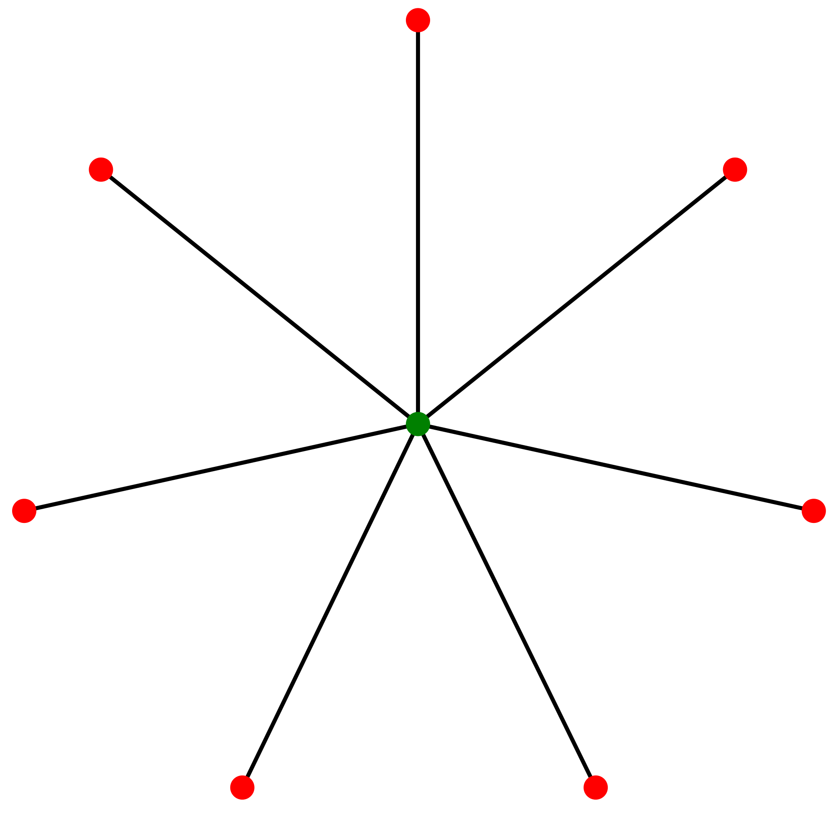
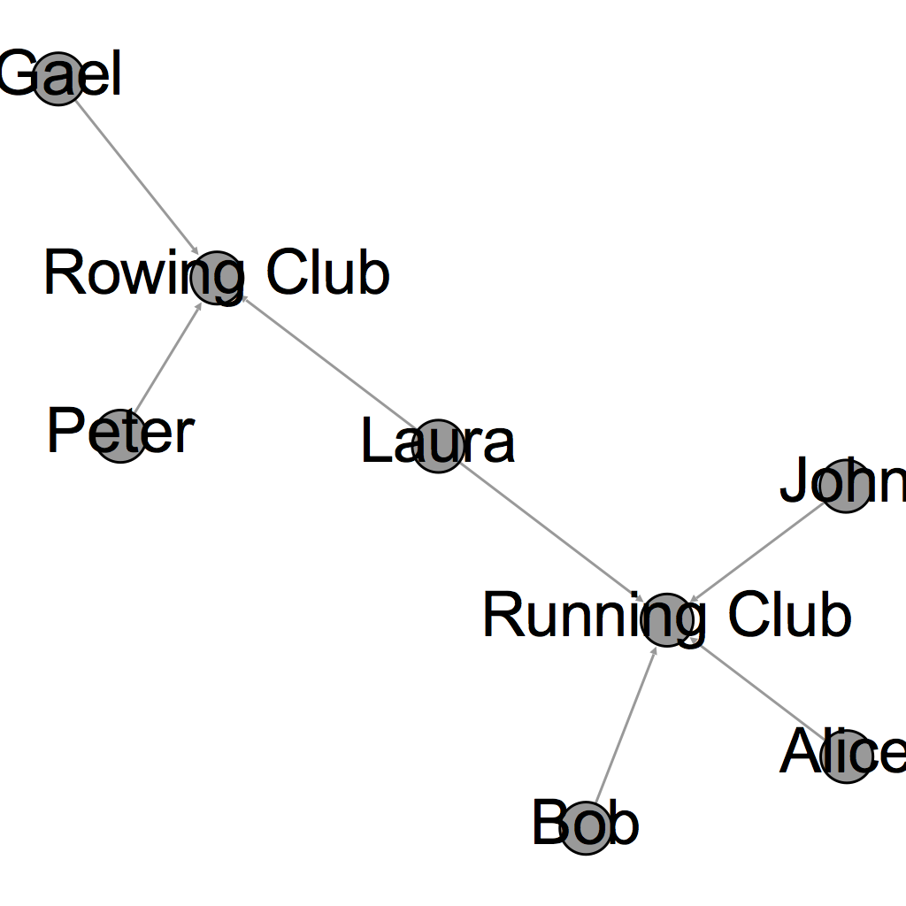
Communication networks
Dynamic network?
Alternative to sender-recipient
networks:
Person -> Topic
Person -> Concept
Person -> ...
Models developed in organisational studies, epidemiology, “rumor networks”, diffusion of innovations

Slide 51
Exploration of linkable datasets
Best practices in Linked Data
Pelagios project
http://histograph.eu (adds crowdsourcing)
deutsche-biographie.de
ePistolarium
http://kindred.stanford.edu/#
Slides “Historische Netzwerkforschung und Semantic Web”
Challenge to conduct original research based on metadata

Slide 52
Cinema history
Exploration: Who is connected to whom?
Work with bipartite networks (e.g. films –shown in-cinemas)
E.g. http://raw.densitydesign.org/ has many straightforward data viz tools for exploration
Missing data: At least 80-90% correct data necessary for reliable centrality computations*
Models in economics
Collaborations with geographers?
Exponential Random Graph/Agent-based modeling for hypotheses-testing
* Borgatti et al., http://www.researchgate.net/publication/222427938_On_the_robustness_of_centrality_measures_under_conditions_of_imperfect_data

Slide 53
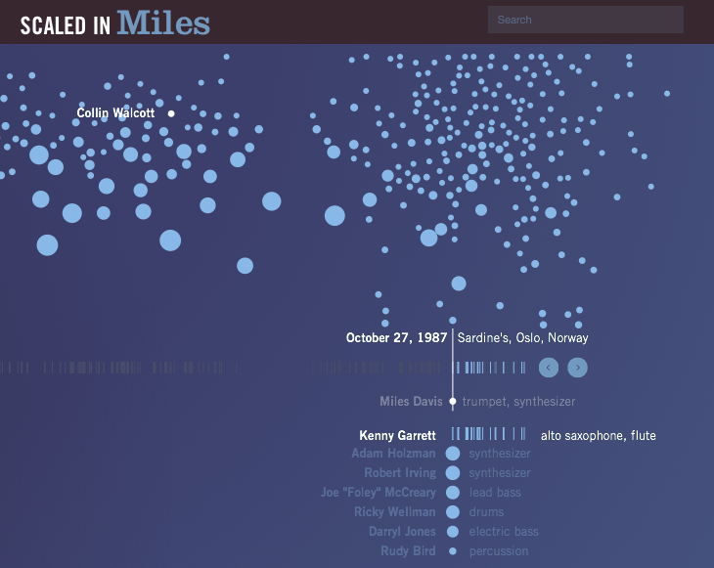
Musical genres
http://fathom.info/miles-web/

Slide 54
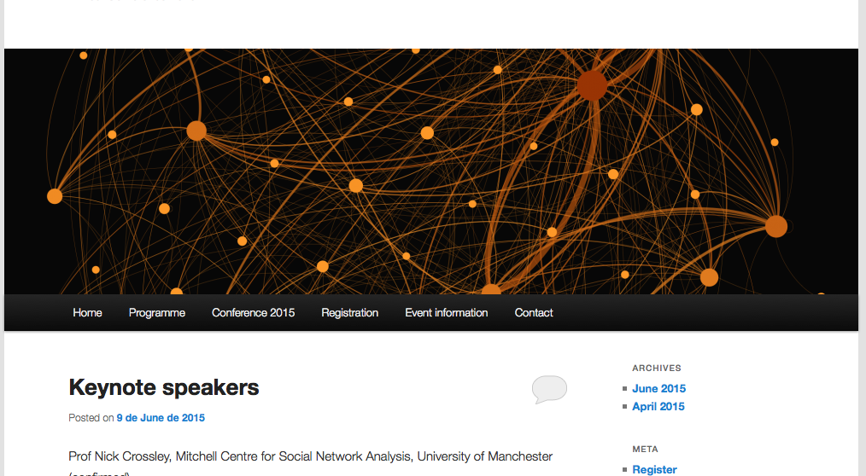
HNR Conference 2015 in Lisbon
https://historicalnetworkresearch2015.wordpress.com/

